Slide 1











24TH APRIL 2025
MARKETING ANALYTICS - EKIMETRICS
HOPE ST
COSMETICS
VANSHIKA GUPTA

Slide 2
Meeting Objectives
01.
Scope and Approach​
02.
Executive Summary​
03.
Key Insights
PERFORMANCE DECOMPOSITION​
GAP ANALYSIS ​
ROI SCORECARD​
TWO DEEP DIVES

Slide 3
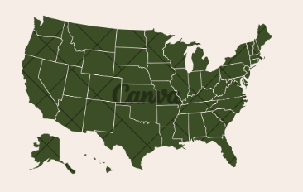


Scope
United States (Total Business)
1 Model Total Sales across channels
January 2019 – December 2020
Weekly Granularity (Monday start)

Slide 4
Approach
1. Industry Context and Sector Exploration
Analyzed the U.S. beauty market and competitive landscape with an emphasis on the luxury segment to reflect Hope Street Cosmetics' brand identity.
2. Data Collection & Treatment
Compiled 2019–2020 weekly data on media spend, promotions, and external factors; cleaned and structured the dataset for model readiness.
3. Model Development
Built a Marketing Mix Model incorporating adstock, lag effects, and seasonal dummies, including a custom seasonal variable (womens_day) —to capture campaign dynamics.
4. Insights & Recommendations
Identified key ROI drivers, underperformers, and COVID-19’s impact on media performance.

Slide 5
Executive Summary
Section | Insight | Recommendation
Media Performance | Digital media’s contribution rose from 7.6% to 19.3%, driven by strong ROI in Social (17.1) and Search (10.2). TV and Print saw declining ROI, and baseline contribution dropped. Promotions also saw a slight decline. | Increase spend on high-performing digital channels like Social and Search. Use TV and Print more selectively for brand awareness.
Promo Performance | Promotions contributed to a $18.7M decline in sales between 2019 and 2020, likely due to fewer campaigns and shifting consumer priorities during COVID-19. | Optimize promotional timing and formats - consider reallocating toward digitally integrated promotions during high-response windows to recover the ~5% drop in contribution from 2019 to 2020.
Covid Impact | Social delivered the highest ROI (15.7) with minimal spend, followed by Search (8.1). TV drove high contribution with ROI (4.5). Print and Display underperformed(ROI < 3), and Outdoor wasn’t used, likely due to lockdowns. | Increase investment in Social and Search. Refine TV strategy to retain reach. Reduce spend on Print and avoid Outdoor during times of limited mobility.
Other Findings | TV-Coop ROI dropped from 4.5 to 2.4, and TV-Pure (introduced in 2020) underperformed with just 1.1 ROI. | TV may need re-strategizing or budget reallocation; consider shifting spend toward more responsive media channels like digital or high-performing print.

Slide 6
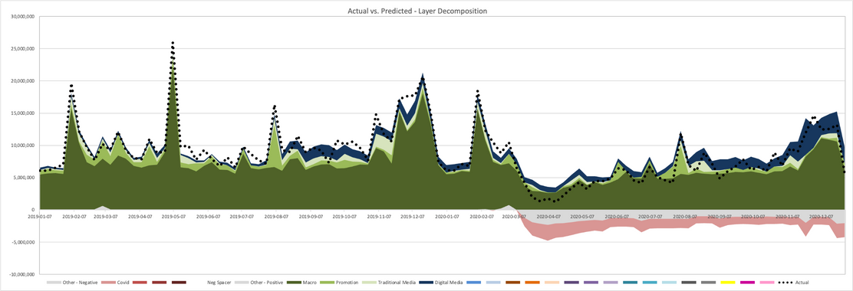
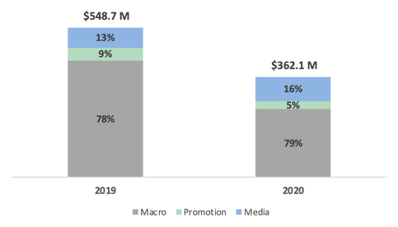
Media Performance
MEDIA’S SHARE OF SALES INCREASED FROM 13% IN 2019 TO 16% IN 2020, LED BY DIGITAL CHANNELS
DIGITAL MEDIA, ESPECIALLY SOCIAL AND SEARCH, ACCOUNTED FOR MOST OF MEDIA’S ROI, OUTPERFORMING TRADITIONAL LEVERS
PROMOTIONS SLIGHTLY DECLINED, POSSIBLY DUE TO FEWER CAMPAIGNS DURING COVID​
BASELINE (MACRO) REMAINED THE LARGEST CONTRIBUTOR, BUT DECREASED FROM 76.6% TO 69.5%​
​
WEEKLY SALES BY LEVER​
MEDIA ROI TABLE (TRADITIONAL + DIGITAL)
CHANNEL | LEVER | 2019 | 2020
Traditional Media | TV | 4.5 | 1.9
 | Print | 2.7 | 2.3
 | Outdoor | - | 44.2
Digital Media | Search | 8.1 | 10.2
 | Social | 15.7 | 17.1
 | Online Video | 3.9 | 2.4
 | Display | 2.8 | 4.5
% SHARE OF SALES (STACKED BAR)
Note: ROI shown as $ return per $1 spent (e.g., 17.1 = $17.10 per $1 spent)

Slide 7
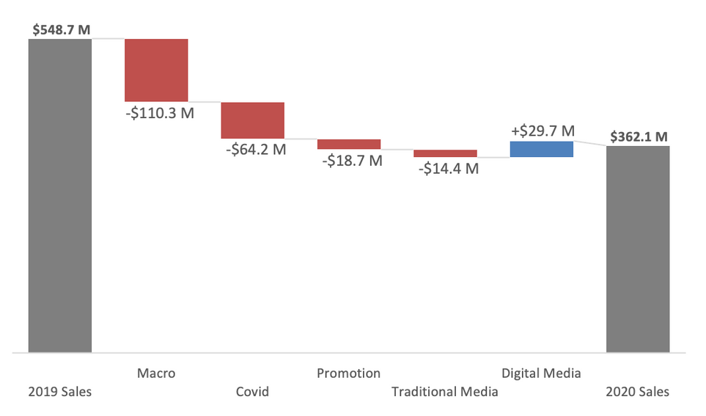
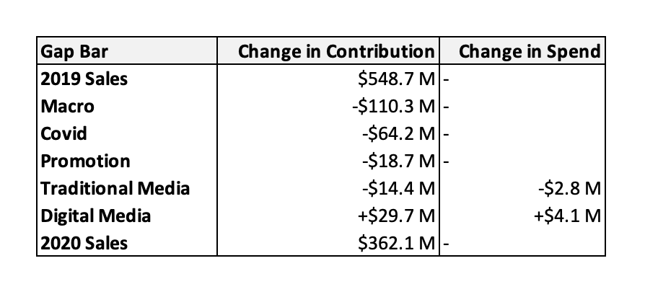
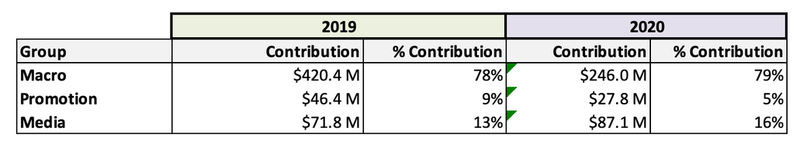
Gap Analysis
KEY INSIGHTS
MACRO CONDITIONS DROVE THE BIGGEST DECLINE (–$110.3M), REFLECTING MARKET CONTRACTION AND WEAKER SEASONALITY
COVID-19 CAUSED AN ADDITIONAL –$64.2M IMPACT DUE TO SUDDEN SHIFTS IN DEMAND AND RETAIL DISRUPTION
PROMOTIONS AND TRADITIONAL MEDIA UNDERPERFORMED, EACH CONTRIBUTING AROUND $15–18M IN LOSSES
DIGITAL MEDIA WAS THE ONLY POSITIVE DRIVER (+$29.7M) FROM JUST A $4.1M SPEND INCREASE, SHOWING STRONG ROI AND SHIFT TO DIGITAL
MARKETING LEVERS (MEDIA + PROMO) GREW IN IMPORTANCE, MAKING UP ~30% OF SALES IN 2020 VS. ~21% IN 2019
DESPITE DECLINE, MACRO/ORGANIC DRIVERS STILL DOMINATED SHARE (FROM 78% TO 86%)

Slide 8
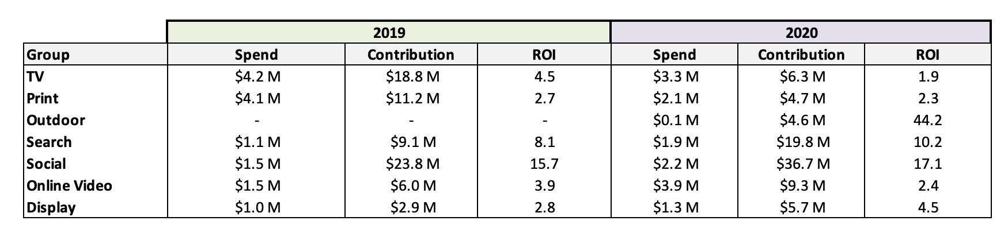
Media ROI Scorecard
SOCIAL MEDIA CONSISTENTLY DELIVERED THE HIGHEST ROI, RISING FROM 15.7 IN 2019 TO 17.1 IN 2020, MAKING IT THE MOST EFFICIENT AND RESILIENT INVESTMENT.
SEARCH AND OUTDOOR DEMONSTRATED STRONG ROI GAINS IN 2020, SEARCH ACHIEVED AN ROI OF 10.2, MAINTAINING HIGH EFFICIENCY WITH MODEST SPEND. OUTDOOR, NEWLY ACTIVATED IN 2020, DELIVERED A STANDOUT ROI OF 44.2, SIGNALING AN EXCEPTIONAL GROWTH.
TV AND PRINT ROI DECLINED SHARPLY, SUGGESTING DIMINISHING RETURNS AND MAY WARRANT BUDGET REALLOCATION TOWARD HIGHER-PERFORMING DIGITAL CHANNELS.
FROM 2019 TO 2020, ALL DIGITAL CHANNELS IMPROVED IN ROI, REFLECTING THEIR GROWING EFFICIENCY AND ADAPTABILITY, ESPECIALLY DURING COVID. IN CONTRAST, TRADITIONAL MEDIA LOST EFFECTIVENESS, LIKELY DUE TO SHIFTS IN CONSUMER BEHAVIOR AND MEDIA CONSUMPTION HABITS.

Slide 9
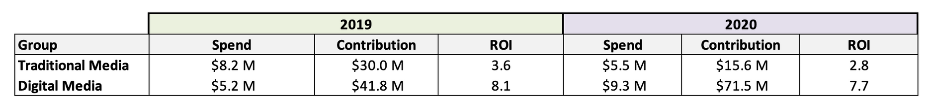
Traditional vs Digital Media
Key Insights
Digital media significantly outperformed traditional
in 2020:
ROI: 7.7 vs. 2.8
Contribution: $71.5M vs. $15.6M
Traditional media efficiency declined, with contribution dropping by nearly 50% despite lower spend, likely due to reduced relevance during COVID.
Digital media scaled effectively, with a 79% increase in spend still maintaining strong ROI, led by Social, Search, and Online Video.
Recommendations
Shift budget to high-ROI digital channels, especially Social, Search, and Online Video.
Limit traditional media to awareness or seasonal bursts where impact is measurable.
Continue scaling digital, testing new creatives to maintain ROI.
Build a data-driven media mix plan focused on efficiency and adaptability.

Slide 10
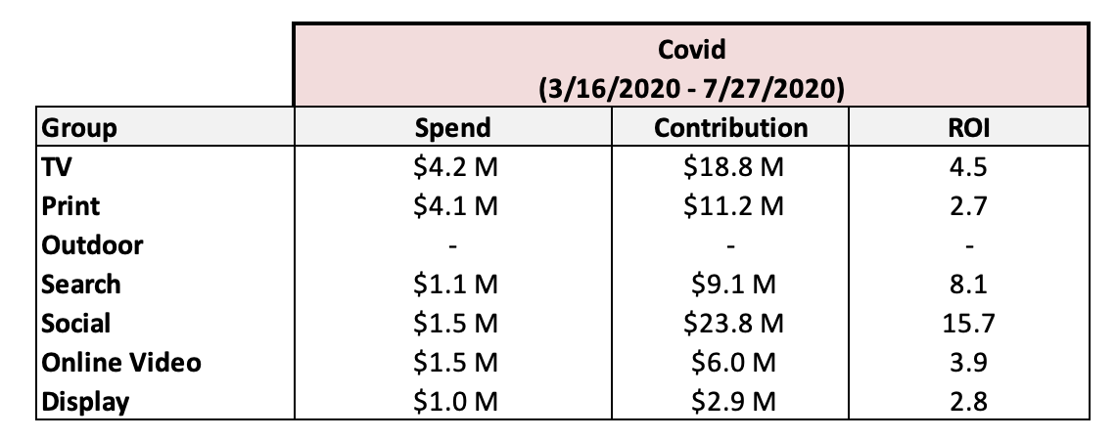
Covid Impact
INSIGHTS
SOCIAL HAD THE BEST ROI (15.7) WITH JUST $1.5M SPEND, DRIVING $23.8M IN CONTRIBUTION.
SEARCH ALSO PERFORMED STRONGLY (ROI 8.1) FROM LOW INVESTMENT.
TV BROUGHT HIGH CONTRIBUTION ($18.8M), BUT LOWER ROI (4.5) THAN DIGITAL.
PRINT AND DISPLAY UNDERPERFORMED WITH LOW ROIS (2.7–2.8).
OUTDOOR WAS NOT USED, LIKELY DUE TO LOCKDOWNS.
RECOMMENDATIONS
INVEST MORE IN SOCIAL & SEARCH – HIGH ROI, LOW SPEND
REFINE TV STRATEGY – GOOD REACH, BUT IMPROVE EFFICIENCY
REDUCE PRINT & DISPLAY – LOW RETURNS
AVOID OUTDOOR DURING RESTRICTED MOBILITY PERIODS

Slide 11
THANK YOU VERY MUCH!

